Slide 1
Work Review: Production Model and Downstream Distribution
6/26

Slide 2
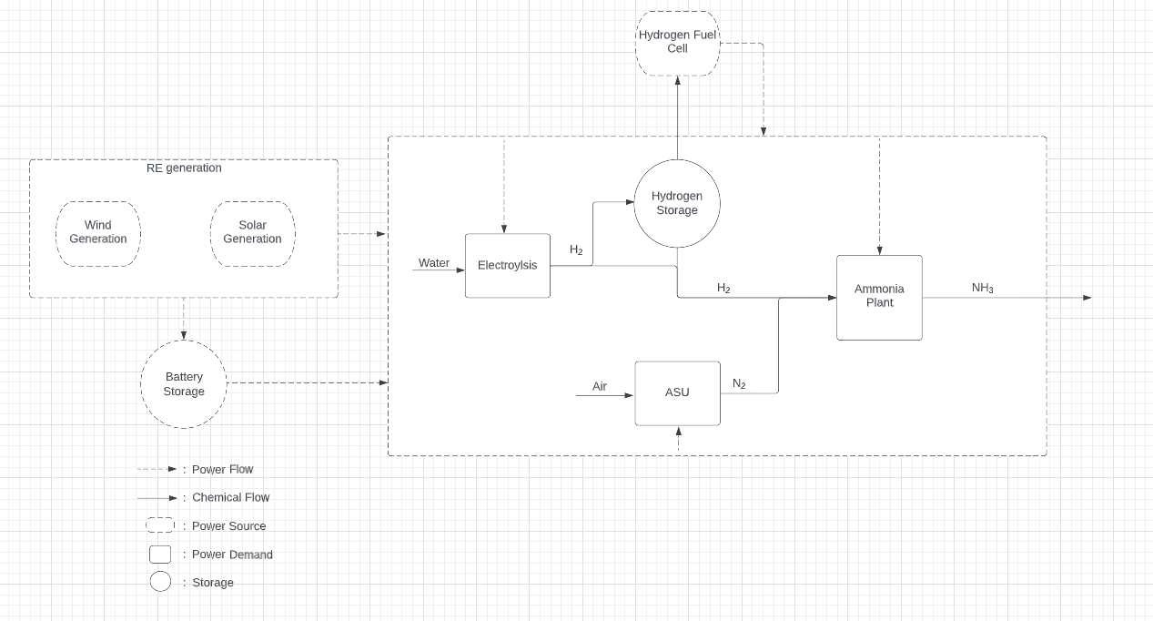
Production Model Schematic

Slide 3
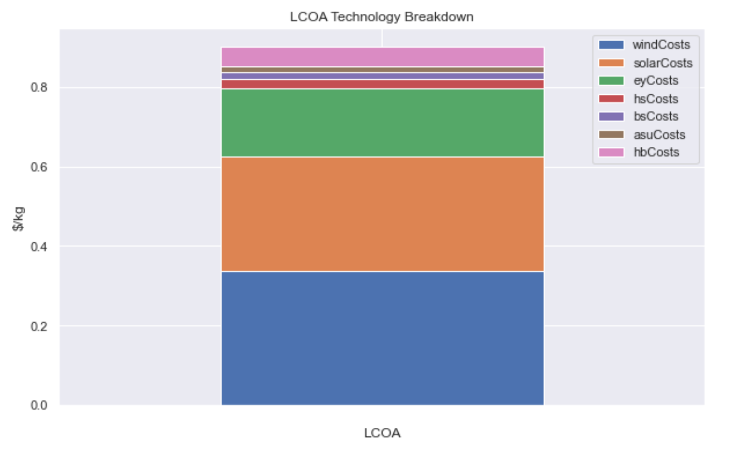
LCOA Output of Production Model Schematic

Slide 4
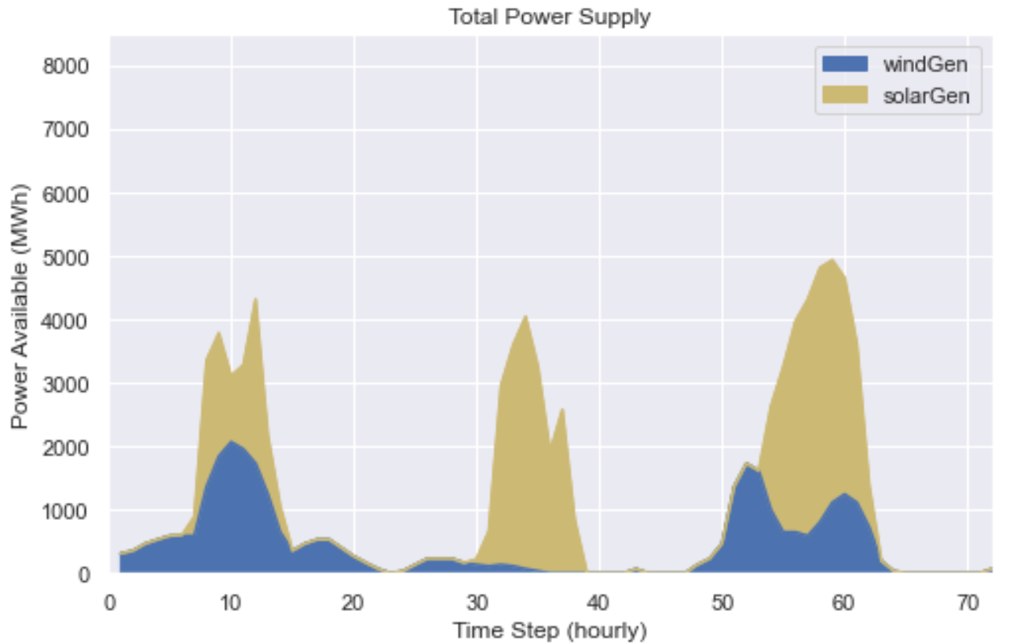
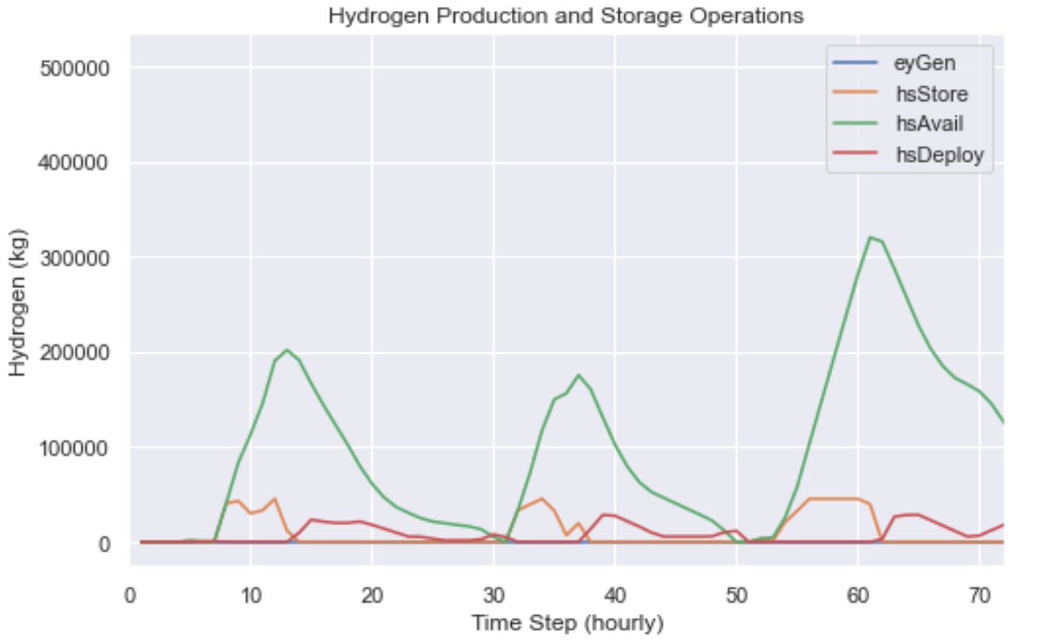
Hydrogen Operations in Ammonia Production

Slide 5
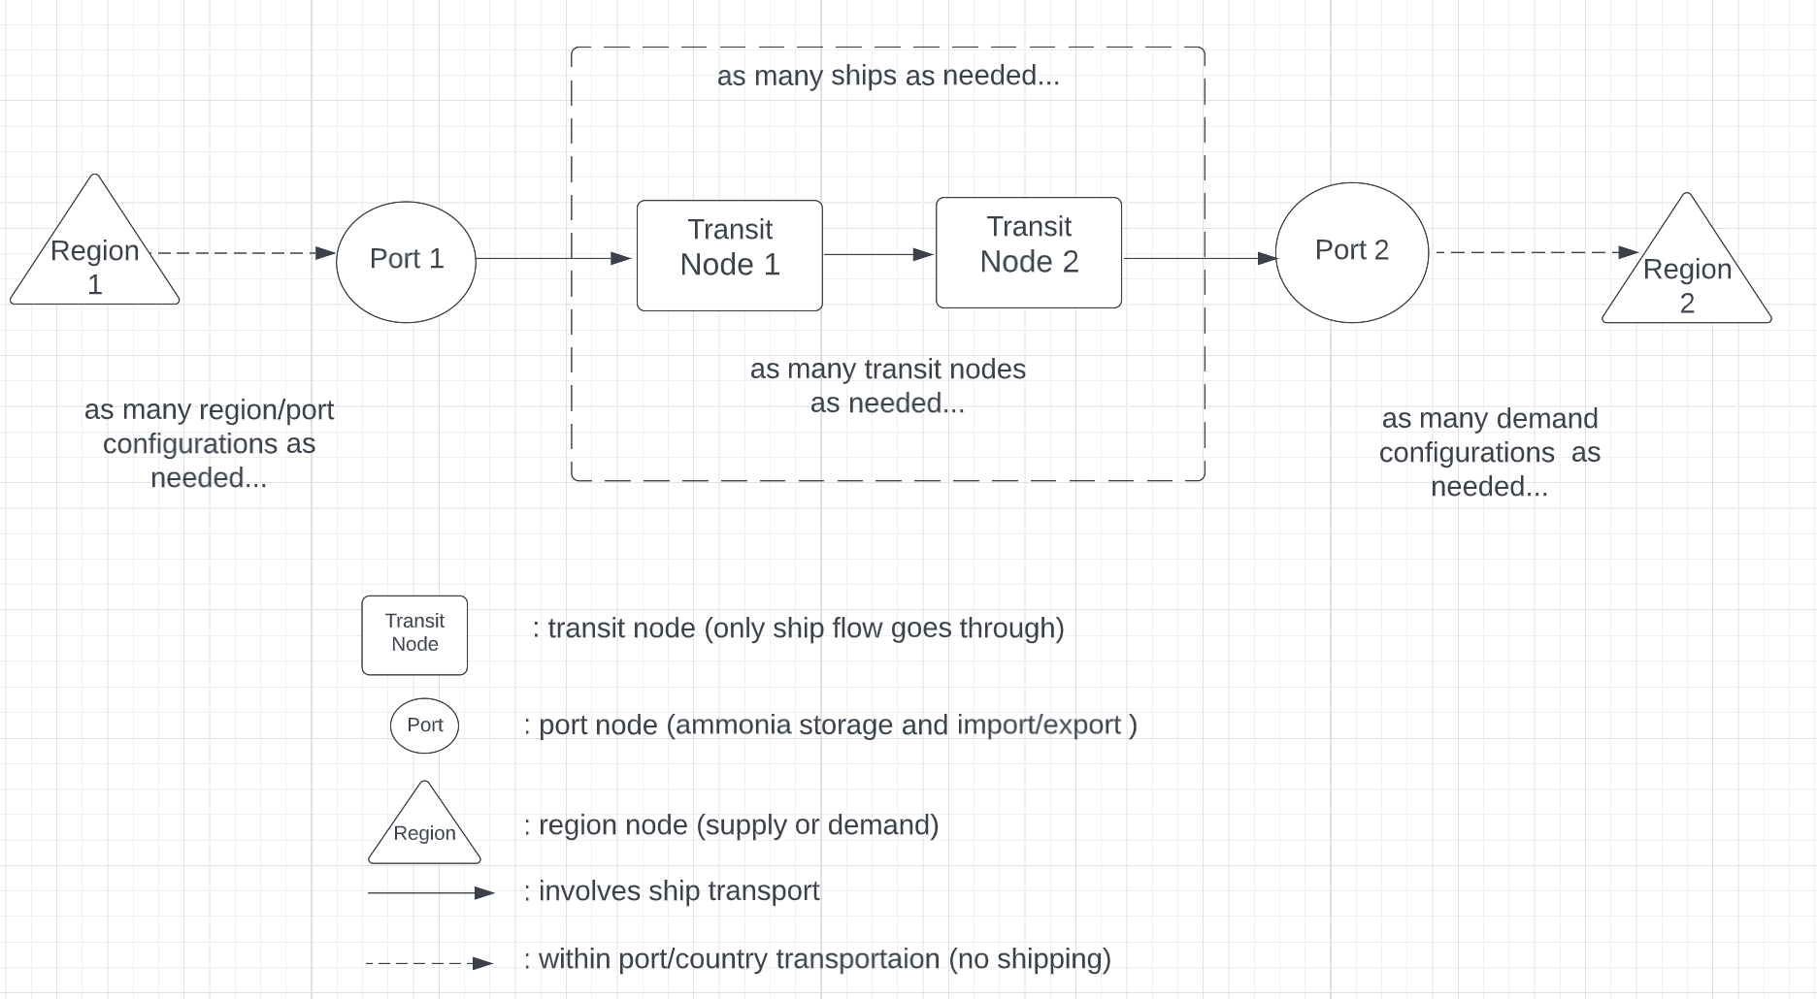
Downstream supply chain Theoretical configuration: node-based network from terminal-terminal
KR, JP, DE, etc..
SA

Slide 6
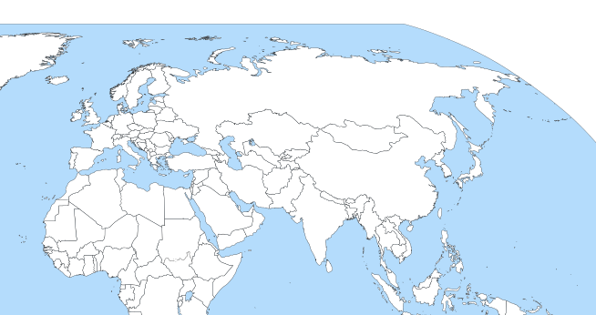
Downstream supply chain Applied configuration: node-based network from terminal-terminal

Slide 7
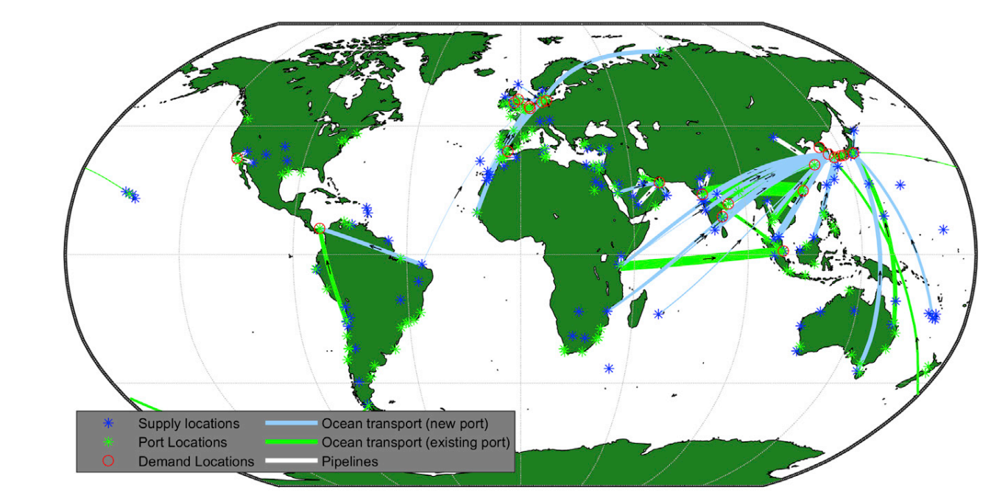
Model output vision: dynamic representation of ammonia flows around the world in conjunction with dynamic production
Visualize the output of green ammonia flows from production in KSA
Resolution can go down to daily or even hourly for ammonia flows
Can decrease # of ports for model runtime
From: Salmon, Nicholas, René Bañares-Alcántara, and Richard Nayak-Luke. "Optimization of green ammonia distribution systems for intercontinental energy transport." Iscience 24.8 (2021): 102903.

Slide 8
Next Steps
Finish recalibrated model validation
After working through the travails of the prior model, the rebuilt network flow is done and now visualizing
Gather real world data once model validation done
Explore cracking heatmaps in country (where centralized vs decentralized takes place)

Slide 9
Questions that can be explored with downstream model
How does the dynamic demand profile of an import country impact overall DLCOA (and thus optimal partners)
Most novel aspect of work
Countries to explore: UK, Germany, Japan
How does incorporating equity/security considerations change the DLCOA
E.g. must have shipments every x days
How do optimal port locations differ (and thus network structure) versus modern terminal structures
Can have two runs: 1. import terminals provided, 2. import terminal locations optimized

Slide 10
Model requirement #1: Decide the structure of the supply chain
Inputs
Production
Demand
Financial considerations of ports/ships
Outputs
Optimal number and types of ships
Import port locations
Import port sizes (both handling and storage size)
Model dimensions
Will follow similar details of the green ammonia model providing a detailed yet still black box overview

Slide 11
Model requirement #2: Decide the daily(or finer) operations of the supply chain
Inputs
Production of Ammonia
Demand of Ammonia at each region
Can create multiple different scenarios for demand to explore sensitivity under different conditions
Outputs
Scheduling of shipments between ports
Operation of storage of ammonia in ports

Slide 12
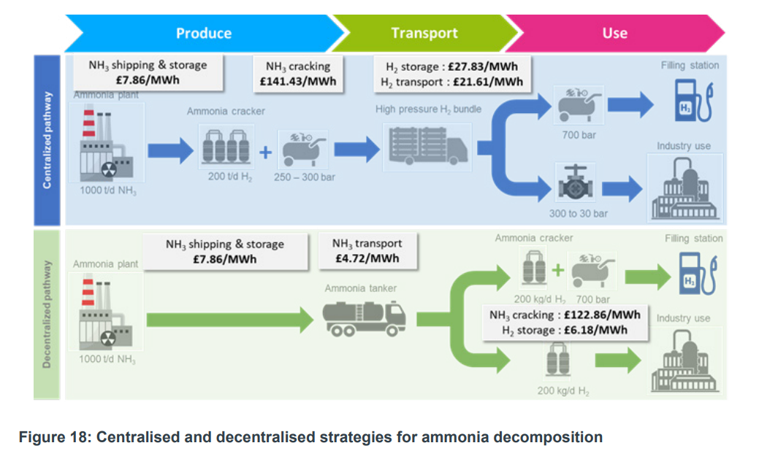
Would still like to incorporate the centralized vs decentralized cracking aspect back to hydrogen in the import country-can be done in heatmap scenarios
Source HS420_-_Ecuity_-_Ammonia_to_Green_Hydrogen.pdf (publishing.service.gov.uk)

